Slide 1
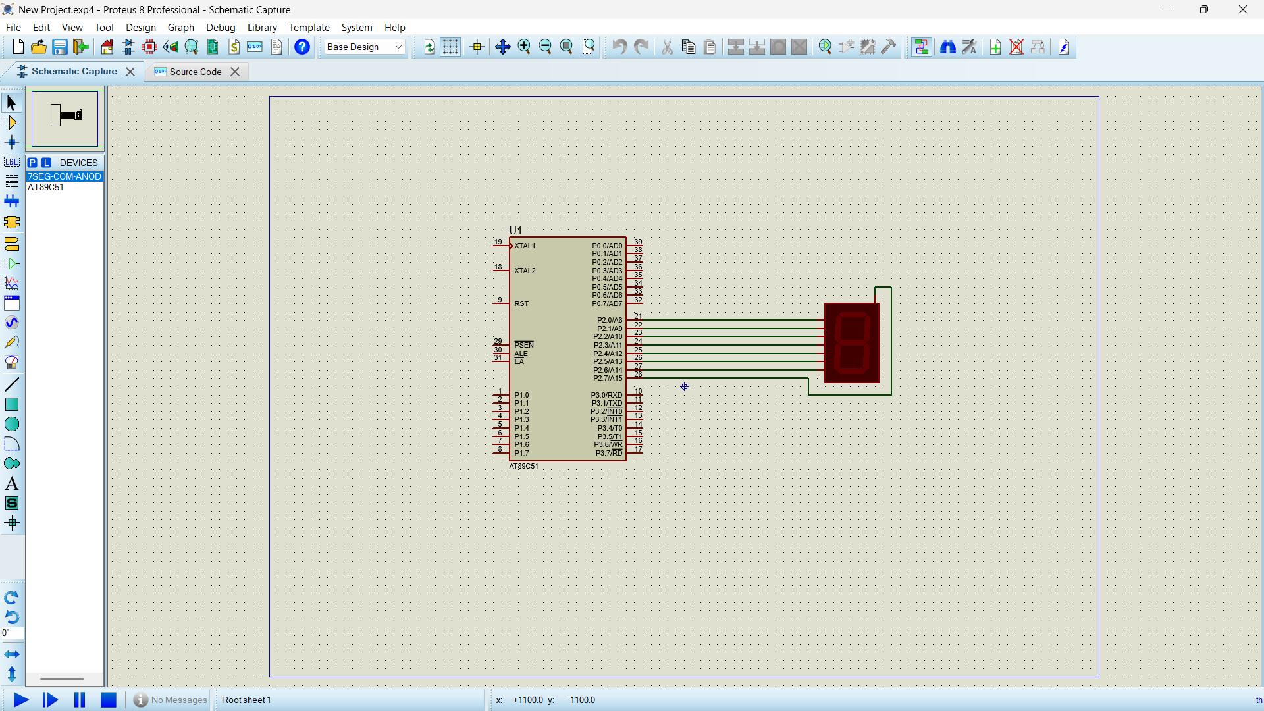
7 SEGMENT DISPLAY USING AT89C51 USING PROTEUS
Objectives
To interface a 7 segment display with AT89C51
To display decimal digits using segment data
To understand output display interfacing
CIRCUIT DIAGRAM
Program
ORG 000H
UP:MOV P2,#0C0H
ACALL DELAY
MOV P2,#0F9H
ACALL DELAY
MOV P2,#0A4H
ACALL DELAY
MOV P2,#0B0H
ACALL DELAY
MOV P2,#99H
ACALL DELAY
MOV P2,#92H
ACALL DELAY
MOV P2,#82H
ACALL DELAY
MOV P2,#0F8H
ACALL DELAY
MOV P2, #80H
ACALL DELAY
MOV P2,#90H
ACALL DELAY
DELAY: MOV R5,#10
H1:MOV R4,#180
H2:MOV R3,#255
H3:DJNZ R3,H3
DJNZ R4,H2
DJNZ R5,H1
RET
END

